Slide 1
YouTube Trending Video Analysis and Predictions
Sanjeev Sriram

Slide 2
Introduction
YouTube's Trending section spotlights captivating videos with broad appeal, aiming to showcase content that has the potential to become viral and attract a substantial audience. Referred to as trending videos, these are updated every 15 minutes and are accessible globally, with personalized lists for different regions. The YouTube algorithm assesses various factors to determine inclusion in the trending list:
View count: Videos garnering a high number of views in a short timeframe.
Engagement: Videos that foster interaction through likes, dislikes, comments, and shares.
Relevance: Videos tied to current events, popular culture, or trending topics.
Freshness: Recently uploaded or actively viewed videos are more likely to trend.

Slide 3
Background
YouTube, the largest video-sharing platform, relies on factors like views, likes, comments, and audience engagement to determine video reach and trending status.
This project focuses on analyzing variables affecting YouTube video trends, using NLP and sentiment analysis to assess comments. Achieving over 90% accuracy, it predicts trending videos based on likes, views, and comments

Slide 4
Dataset
Dataset Name: YouTube Trending Video Dataset
Link: https://www.kaggle.com/datasets/rsrishav/youtube-trending-video-dataset/data
Size: 2 GB

Slide 5
Objectives
Identify Influencing Factors:
Analyze variables impacting viral potential and investigate correlation between features
Sentiment Analysis on Comments:
NLP for sentiment analysis on comments
Duration Prediction:
Predicting number of days a video will trend
Metric Predictions:
Predict View count, likes and comment counts

Slide 6
Data Cleaning
Handling Null Values
Data Frame Characteristics: 185,990 rows, 16 column
Duplicate Data Check
Extracting Comments and Duration

Slide 7
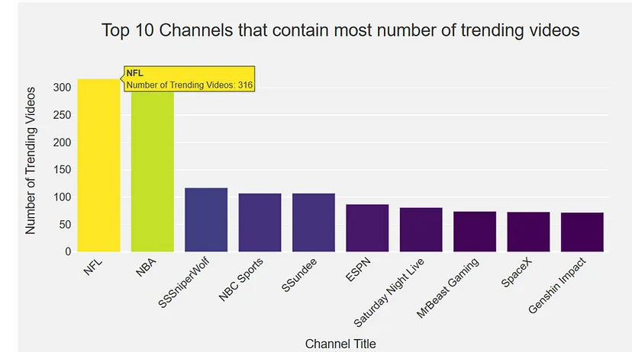
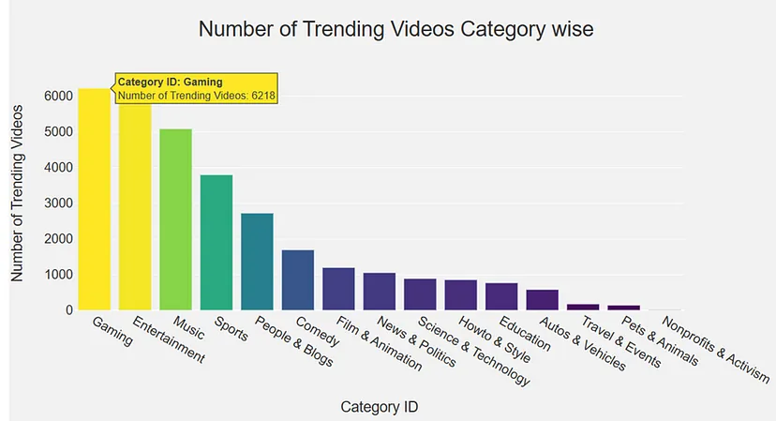
EDA

Slide 8
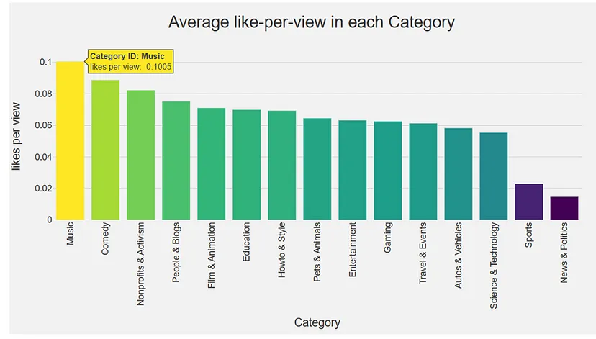
contd…

Slide 9
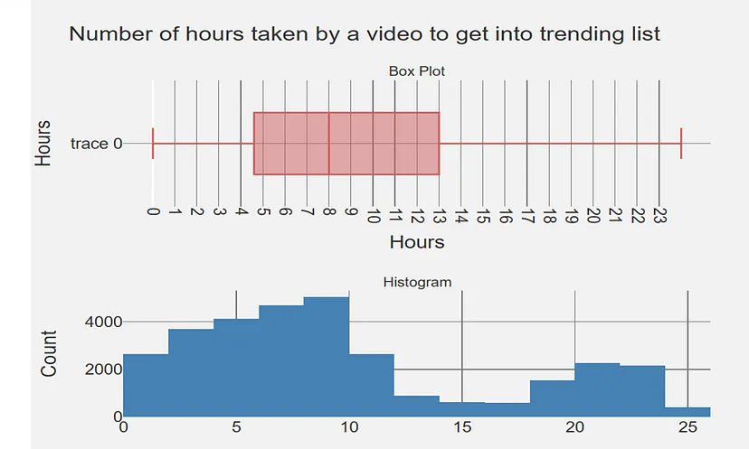
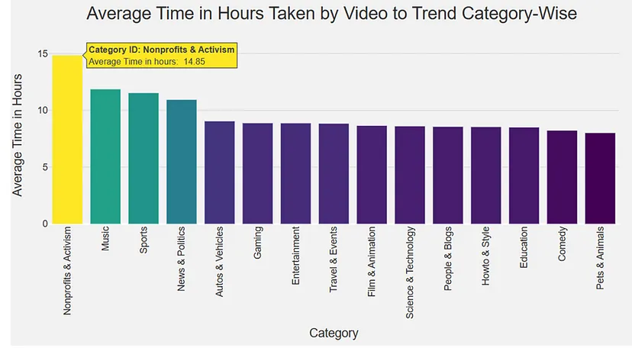
contd…

Slide 10
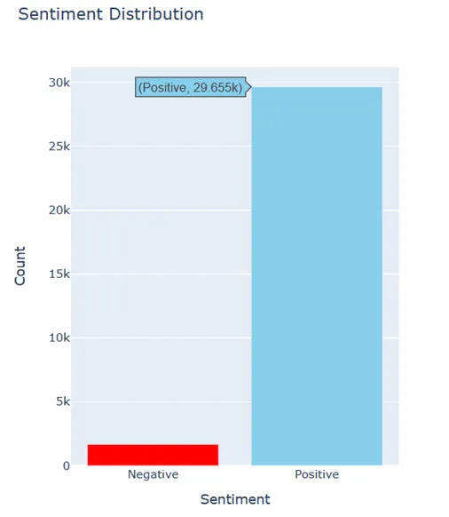
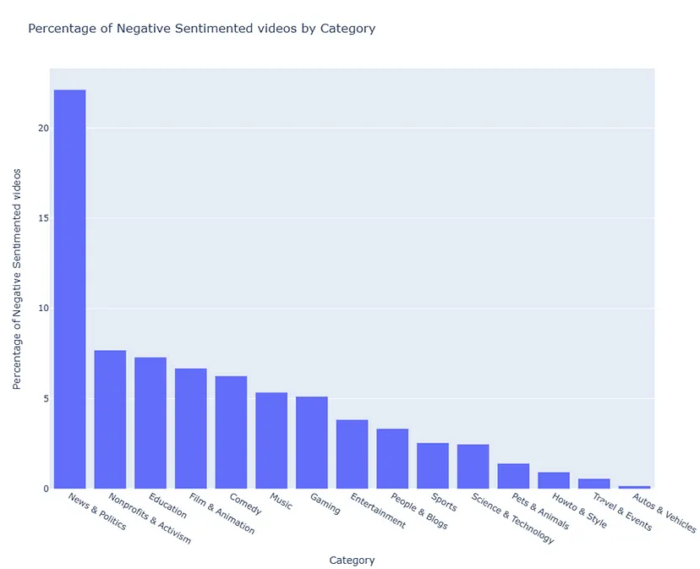
Sentiment Analysis

Slide 11
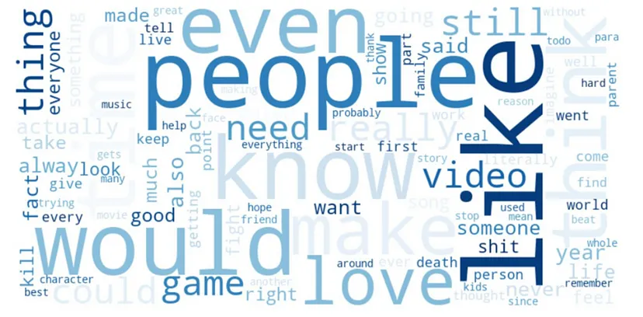
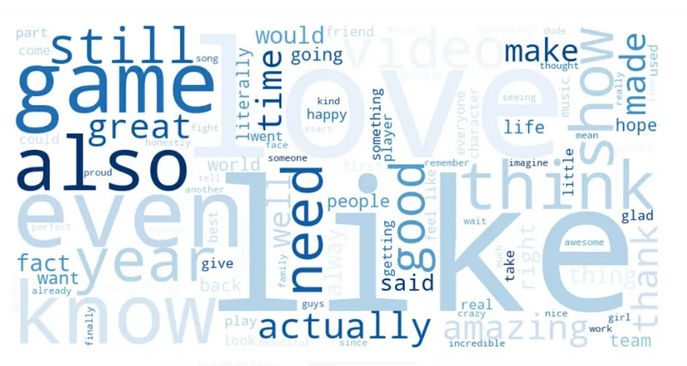
Word Cloud for Negative comments:
*Youtube tends to push positive videos to trending list.
Word Cloud for Positive Comments

Slide 12
Model Building Overview
Purpose:
Understand and predict various aspects of YouTube video trends.
Utilize machine learning techniques for accurate predictions.
Target Variables: Views, likes, comments, and trending duration.
Approach:
Linear Regression, Decision Tree, and XGBoost algorithms.
Evaluate model performance on training and testing data.

Slide 13
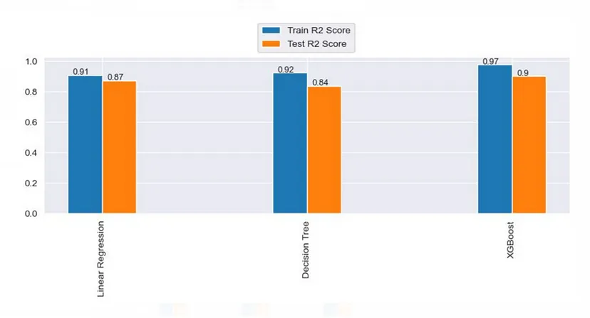
Model to predict the views by the time video gets out of the trending list

Slide 14
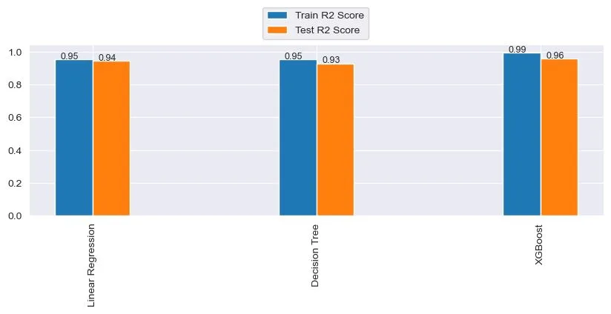
Model to predict the likes by the time video gets out of the trending list

Slide 15
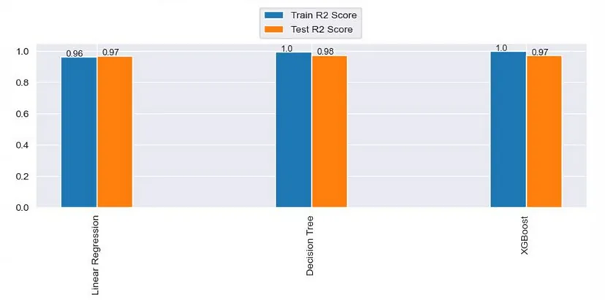
Model to predict the comment count by the time video gets out of the trending list

Slide 16
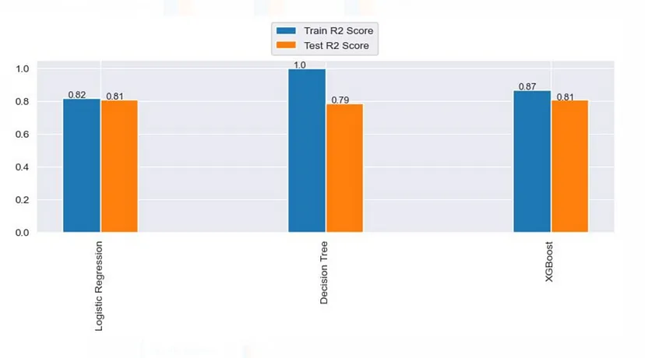
Model to Predict the Number of trending days

Slide 17
Conclusion
The Analysis unveiled crucial factors driving YouTube video trends:
View count, likes, comments, and video duration.
Elevated engagement, particularly in views and likes, correlates with increased trend likelihood.
Gaming, entertainment, and music dominated trending content. Positive sentiment in comments aligns with YouTube's algorithm preference.
Created machine learning models, achieving over 90% accuracy, to help creators optimize content for broader audience reach and viral success.

